Slide 1
Overview / Objectives / Description
Introduction
What is B.I. Essentials ?
B.I Essentials is a concept to dynamically identify elements in PLM Structure.
What is the value of customizing B.I Essentials ?
Proposed customer B.I. to identify what he wants and as he wants with:
His own colors
His own labels
His own rules (values of such attributes result to such color and label)
Easy To:
Implement
Test

Slide 2
Agenda
How to use B.I. Essentials
How to customize it.
B.I. Essentials Checker
Tips
Going Further (DSDoc)

Slide 3
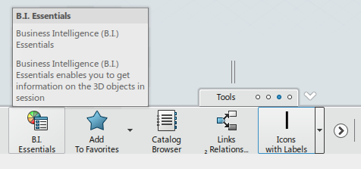
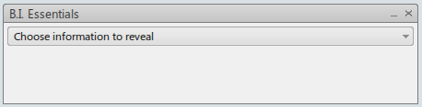
How to Use B.I. Essentials
How To Access
In the action bar, select the Tools Tab/Section (1)
In the Tools Tab/Section select th B.I Essentials Button/Command (2)
The B.I. Essentials Menu appears (in a Top-Right corner)
1
2

Slide 4
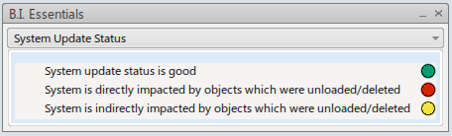
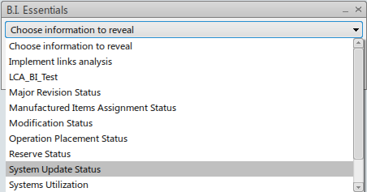
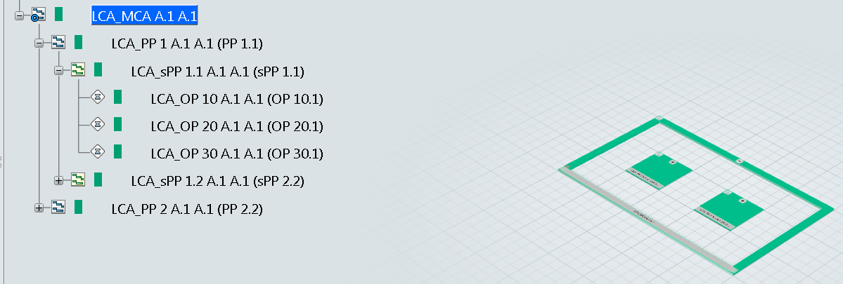
How to Use B.I. Essentials
Use (1/2)
In the drop-down list, select the B.I.
The legend appears under the drop-down list, with colors pastils and their descriptions
Color rectancle appears between icon and titles of elements, corresponding to element state (according to rules of B.I. selected).
The tiles are also colored (with corresponding colors)

Slide 5
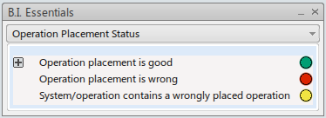
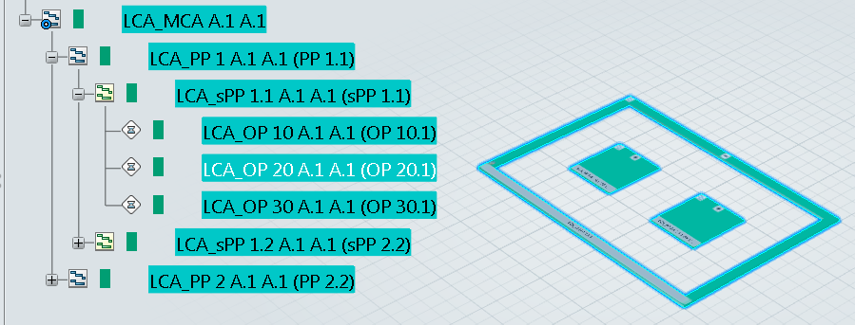
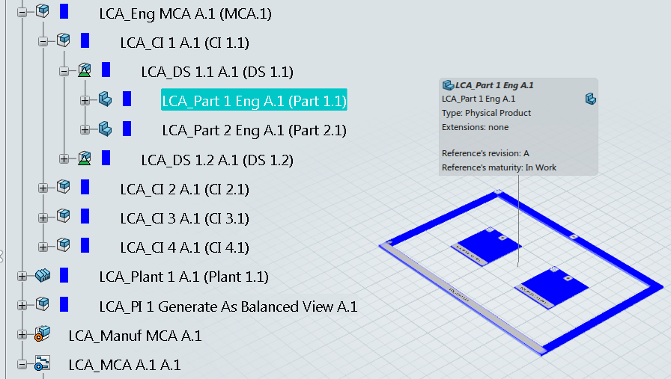
How to Use B.I. Essentials
Use (2/2)
In the legend, if you click on plus (+) button ahead the description, all corresponding elements are selected
If label is defined, when you select an element, in the tree, the label appears.

Slide 6
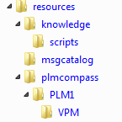
How to Customize B.I. Essentials
Structure
The customization of B.I. consists of few files (*.CATRsc, *.CATNls, *.CATRule) placed in several subfolder of "resources" folder.
Files:
A file named BICusto.CATRsc, containing customized B.I. declarations.
A resource file, by B.I., containing the B.I. definition.
A traduction file, containing the display name of the B.I. and the display description of each cases for the legend.
A resource file, containing the definition of color.
A resource file, containing matching type with rules for color and for label.
Rules files, containing EKL code to define color and label to apply.
Folders:
msgcatalog, containing traduction files.
knowledge\scripts, containing the rules files.
plmcompass, structure of folder containing resource files.

Slide 7
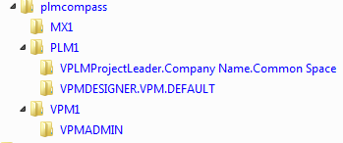
How to Customize B.I. Essentials
Folder plmcompass - Structure
The resources files are localized in subfolders of plmcompass folder.
Structure: a folder by provider, then for each, a folder by role / security context.
If the folder corresponding to connected user role is not defined, it will use the resources files defined directly under provider folder
In case of VPM the resources files are taken in VPM folder (the BICusto can be in provider)

Slide 8
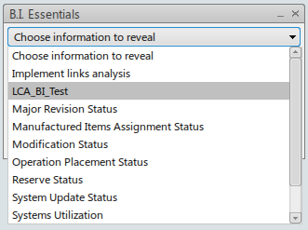
How to Customize B.I. Essentials
BICusto.CATRsc – the declaration file
The BICusto resource file contains the declaration of customized BI.
The name file can not be change.
Contains one line by customized BI.
Line format: <BI ID>.Scope="ALL"
Line example: LCA_BI_Test.Scope="ALL"
Once the file is correctly defined we see the BI in the drop-down list.
(For retrieve the root directory of resource folder see B.I. Essentials Checker in Tips section)

Slide 9
How to Customize B.I. Essentials
The BI definition file
One file by BI
The name file must be <BI ID>.CATRsc.
The content of file define the BI in few properties with following key:
LegendNlsFile → The name of CATNls file, containing the traduction.
ColorRscFile → The name of resource file containing definition of color.
TypeRuleDefinitionFile → The name of resource file containing the mapping of type to rule (for color and label)
Version → Define the level of type "ThisObject" can be in rule. 1 for Reference, 2 for Instance, 3 for occurrence.
NumberOfColors → Define the number of case for this BI.
LegendIdX → Define the technical name of a case (X between 1 and NumberOfColors).
ColorIdX → Define the color of a case (X between 1 and NumberOfColors).
Example: LCA_BI_Test.CATRsc LegendNlsFile="LCABITestNLSFile"; ColorRscFile="LCABITestColorFile"; TypeRuleDefinitionFile="LCABITest_Ass"; Version="3"; NumberOfColors="3"; LegendId1="OK"; ColorId1="Green"; LegendId2="Warning"; ColorId2="Orange"; LegendId3="KO"; ColorId3="Red";

Slide 10
How to Customize B.I. Essentials
The BI Traduction file
Contains the display name of BI and description / legend of case.
The file name must be <value of LegendNlsFile declared in BI definition file>.CATNls
The file content is a properties format wich key are:
<BI ID> for its display name
<Value of LegendIdX> for description / legend of case X.
Example: LCABITestNLSFile.CATNls LCA_BI_Test="LCA BI Test"; OK="Ok to push"; Warning="Warning missing some infos"; KO="Ko to push. Missing mandatory infos";

Slide 11
How to Customize B.I. Essentials
The BI Color definition file
Contains the definition of color in RGBA.
The file name must be <value of ColorRscFile declared in BI definition file>.CATRsc
The file content is a properties format wich a line by color:
Key: <Value of ColorIdX>.RGBA
Value: R|G|B|A. Where R,G,B is a interger value between 0 and 255. And A, for alpha, is the value for the transparence, but actually (currently) does not work, let 0.
Example: LCABITestColorFile.CATRsc Green.RGBA="0|255|0|0"; Orange.RGBA="255|165|0|0"; Red.RGBA="255|0|0|0";

Slide 12
How to Customize B.I. Essentials
The BI Rule Type Association file
Contains the matching type with rules for color and for label.
The file name must be <value of TypeRuleDefinitionFile declared in BI definition file>.CATRsc
The file content is a properties format wich a 2 line by type, one for color and one for label:
Key: Color|Label.Rule.<Type>
Value: The name file (without extension) of the EKL code / CATRule to apply for this type.
The rule for color and label can be put in the same file.
Example: LCABITest_Ass.CATRsc Color.Rule.ACN_DELLmiGeneralOperationReference_Operation = "LCABITest_OP_Color"; Label.Rule.ACN_DELLmiGeneralOperationReference_Operation = "LCABITest_OP_Color";

Slide 13

How to Customize B.I. Essentials
The Rule / EKL Code file
Contains the EKL code to define color and/or label to apply.
The file name must be <value declared in Rule Type Association file>.CATRule
The file content is a EKL code.
Use ThisObject object to have access to the current object (attributes, linked objects, …) Type of ThisObject is Reference or Instance or Occurrence, according to Version defined in The BI definition file. (But do a check, sometimes is not of expected type, exemple, fasten in version 3 is an Instance instead of an Occurrence)
Use Parameters object to define color and label for the current object (with method SetAttributeString and param/attribute MyColorForPLMCompass/MyLabelForPLMCompass).
To set the color use: Parameters.SetAttributeString("MyColorForPLMCompass", <Color Id>)
To set the label use: Parameters.SetAttributeString("MyLabelForPLMCompass", <Label>)
<Color Id> is the value of color id (ex " Green ") or legend id (ex "OK") defined in The BI definition file.
< Label> is a string of this format: <index row>|<Text to display>|<Icon>|<index row>|<Text to display ……where:
<index row> is the line number
<Icon> is the "id" of icon to display at the end of the line
I_noIcon
I_Green
I_Red
……
Example of Label: "1|PPRContext attributes:|I_noIcon|2|Description: "+sDescription+"|I_Red" (sDescription is a string variable containing the description of the PPR)

Slide 14
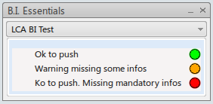
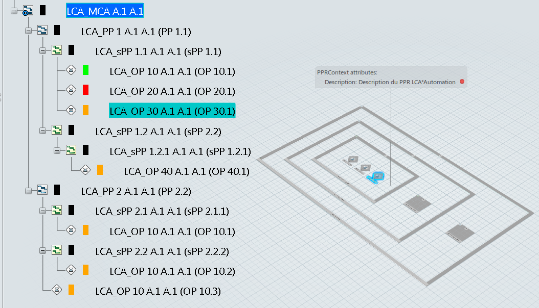
How to Customize B.I. Essentials
Resultat:

Slide 15
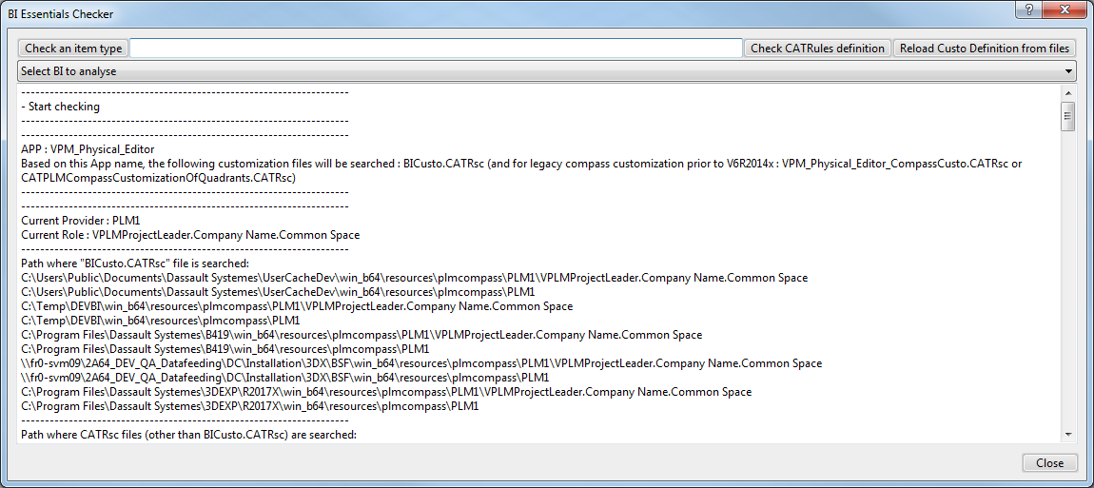
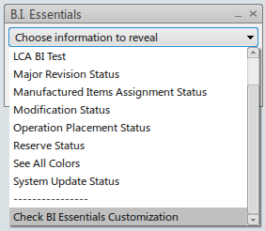
B.I. Essentials CHECKER
B.I. Essentials Checker is a tool:
Accessible at the bottom of B.I. Essentials drop down list.
Show where BICusto file is searched.
Can show what attributes are accessibles (in CATRule/EKL Script) for a given type.
Can show syntax errors.
Can reload customization definition files.
Can analyze a given customized BI
B.I. Essentials Checker Accessibility:

Slide 16
B.I. Essentials CHECKER
B.I. Essentials Checker – Where BICusto file is searched:
Once B.I. Essentials Checker is launched you can see where BICusto file is searched. (and below where Resources files is searched)

Slide 17
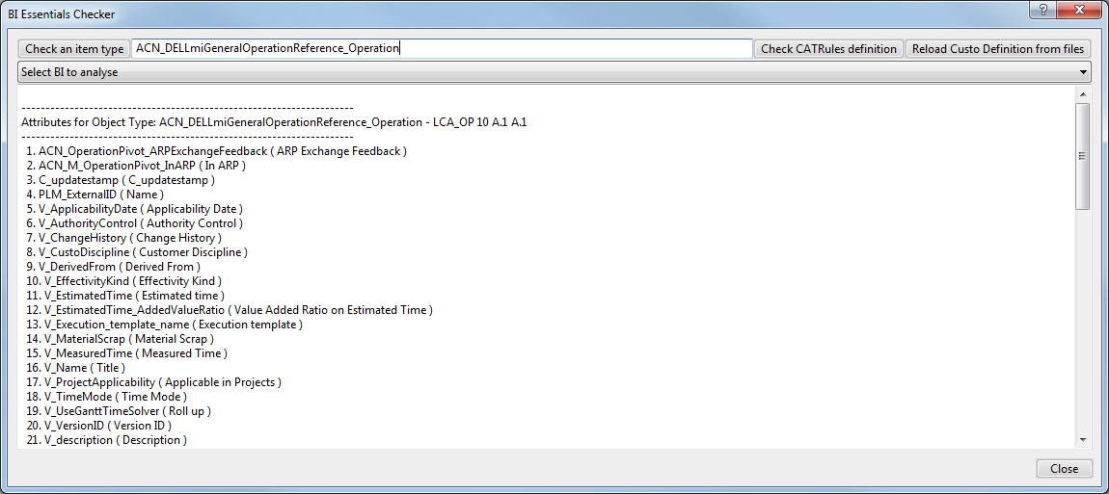
B.I. Essentials CHECKER
B.I. Essentials Checker – Show accessibles attributes:
Click the "Check an item type" button, in the top-left corner.
The B.I. Essentials Checker windows disappears.
Select, in the tree, or the geometry of, the object you want to check.
The B.I. Essentials Checker windows reappers with:
Technical Type (1), is the string to use in TypeRuleDefinition resource file.
Attributes accessibles (2) (in the CATRule/Script EKL)
1
2

Slide 18
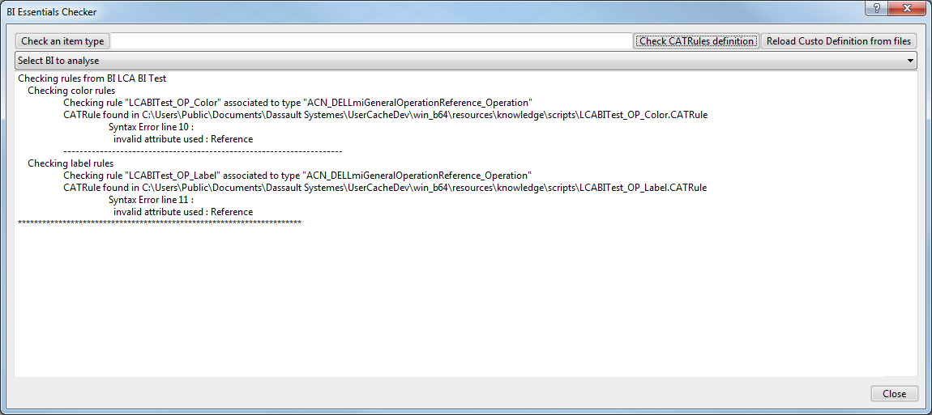
B.I. Essentials CHECKER
B.I. Essentials Checker – Show syntax errors:
Click the "Check CATRules definition" button, in the top-right corner (1).
The B.I. Essentials Checker shows (2), for each association color/type and label type:
Where CATRule is founded
Syntax errors (if there has)
1
2

Slide 19
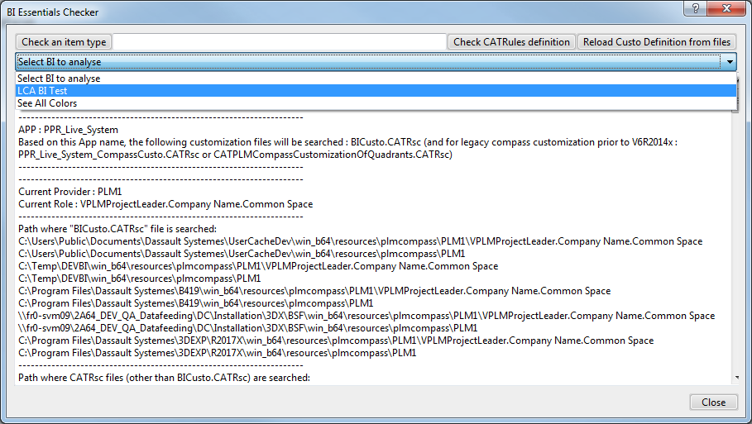
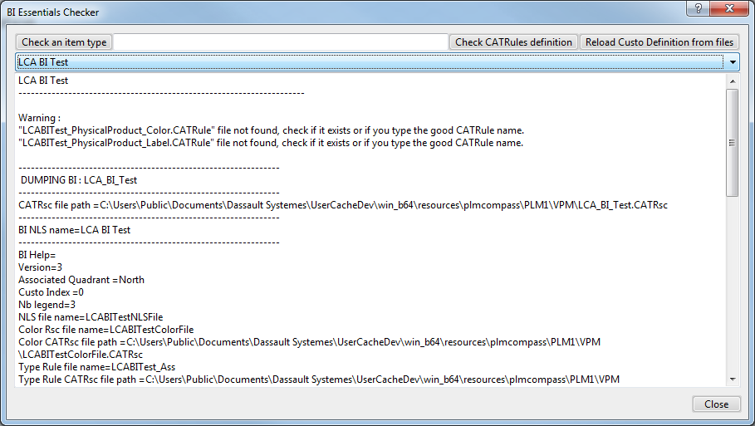
B.I. Essentials CHECKER
B.I. Essentials Checker – Reload & Analyse:
Click the "Reload Custo Definition from files" button, in the top-right corner (1) to reload the customization (in case of change during the session, may not work, in this case restart the session).
Select your BI in "Select BI to analyse" drop-down list (2), to analyse it
The B.I. Essentials Checker shows (3) this analyze.
1
3
2

Slide 20
TIPS
To know where to place BICusto.CATRsc file use B.I. Essentials Checker (Open it and find it in the text, see Where BICusto file is searched slide)
To know what is the object type to define in TypeRuleAssociation resource file use B.I. Essentials Checker (see (1) in Show accessibles attributes slide)
To know what type is ThisObject in your CATRule/EKL Script use EKL Trace
Active EKL Trace, in your Env file:
Set CKE_CUSTO_TRACES to 1
Set custoTrace with a path for ekl trace
Add a trace in your code with, ex: Trace(1, "-->Type= "+ThisObject.ModelerType.Name)
See the trace in TraceEKL.txt in previously defined path
Develop the most of your algo in an action in 3DExperience, so you benefit of EKL Editor with syntax check, autocompletion and language browser. (Note: Parameters object does not available in action but is the last line you should be write in your CATRule)

Slide 21
In Short
Create (or update) BICusto.CATRsc
In resources\plmcompass\ (ProviderX\RuleX).
<BI ID>.Scope="ALL"
Create Resource files.
In resources\plmcompass\ProviderX\VPM (or RuleX)
<BIID>.CATRsc, <ColorsDefinitionFile>.CATRsc, <TypeRuleDefinitionFile>.CATRsc
Create Translate file.
In resources\msgcatalog
Create all CATRule file (which described in TypeRuleDefinition file)

Slide 22
Summary
B.I.Essentials can be "simply" customized.
Few resource files, EKL scripts.
B.I. Essentials Checker can help.
Where BICusto.CATRsc file is searched
Reload Custo Definition (Sometimes does not work)
BI Analyse
Show syntax errors
Do not hesitate to use EKL Trace to debug

Slide 23
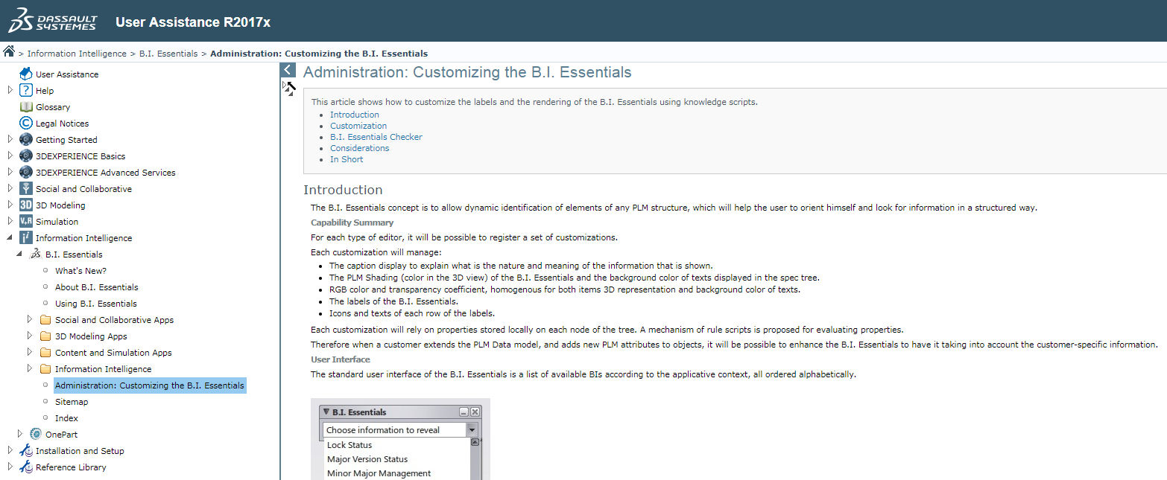
Going further
Online Documentation

